Slide 1
Final Group Project
Wisconsin DOJ Data Analysis
By: Breanna Frankenberg, Kyle Caulkins, Nick Labinski

Slide 2
Purpose
This project examines the Wisconsin Department of Justice's crime data from 2018-2020. Pulling in data,--including education, unemployment, poverty, GDP, alcohol consumption, and poverty--we use unsupervised machine learning to detect correlation between crime and these other variables.

Slide 3
Why Crime?
Gallup Polling
21% of Americans find it an "Extremely Serious"
33% finding it a "Very Serious"
36% finding it a "Somewhat Serious"
Ipsos Polling
61% of Americans believing violent crime is up from the previous year
Americans in cities/urban areas are more less likely to feel safe (65%), than their counterparts in the suburbs (75%) and rural (79%) areas

Slide 4
Why Wisconsin?
Bootcamp/most live in WI
WI DOJ data organized and easy to access
Deeper dive into the different conditions of the counties could provide more insight
Datasets from 2018, 2019, and 2020
GDP data from the U.S. Bureau of Economic Analysis
Educational, population estimates, and poverty data from the USDA's Economic Research Service

Slide 5
Research Questions
What are the factors that might increase or decrease the rate of crime in a county in Wisconsin?
Does educational attainment influence this rate?
Does poverty level factor into the level of crime? Does economic output (GDP) factor into the rate of crime?
Do rates of alcoholic consumption factor into the rate of crime?

Slide 6
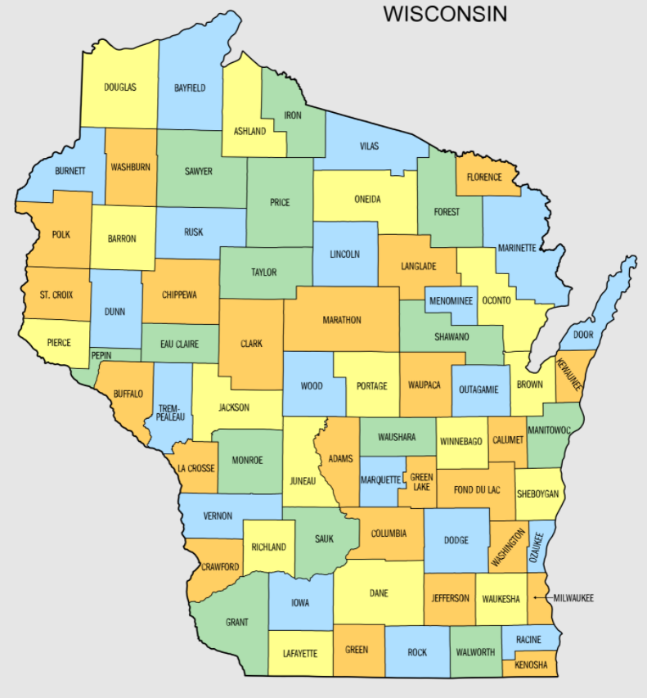
Counties of Wisconsin

Slide 7
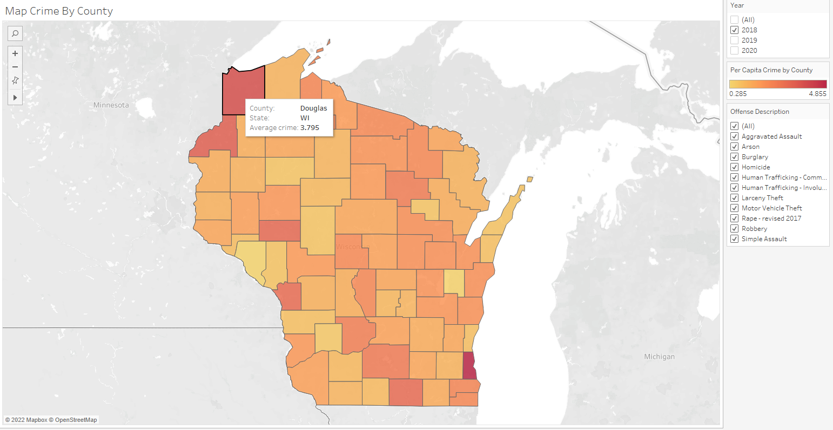
Summary Statistic Crime Interactive Crime Map
Interactive Map
Crime can be sorted by year and offense
Scroll to get statistic of per capita crime

Slide 8
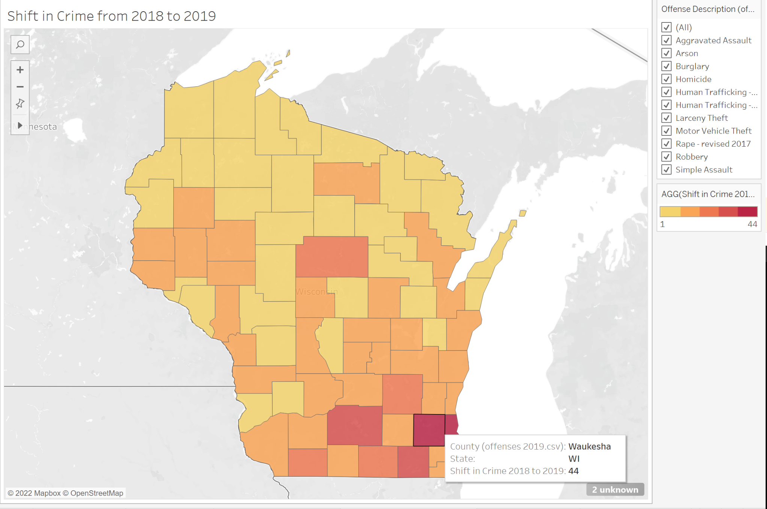
Summary Statistic Crime Interactive Crime Map
Map
Shift in Crime 2018 to 2019

Slide 9
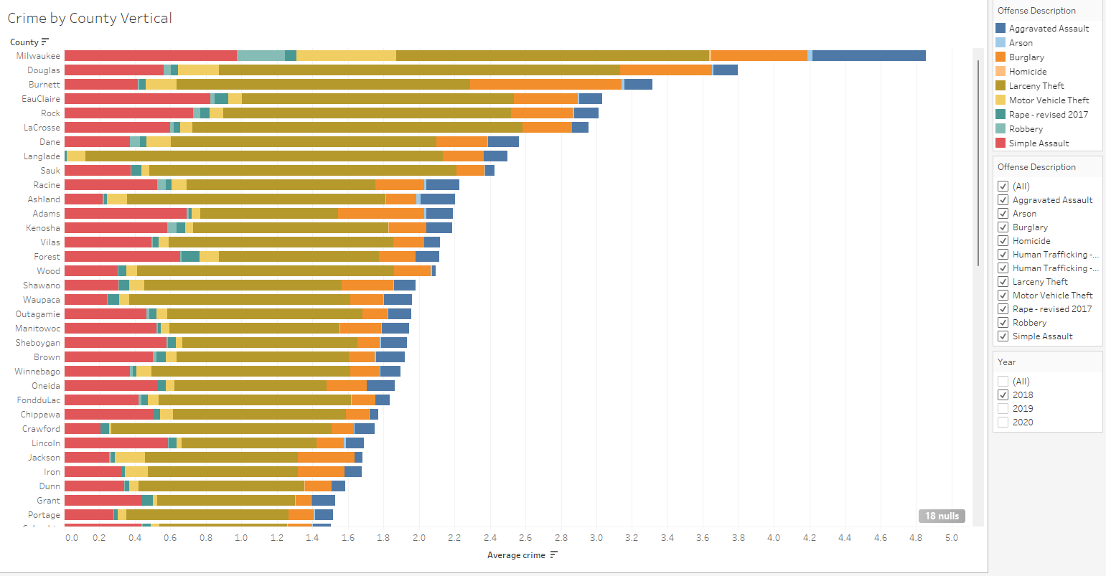
Summary Statistic Crime Interactive Crime Graph
Interactive Graph
Crime can be sorted by year and offense
Scroll to get statistic of per capita crime

Slide 10
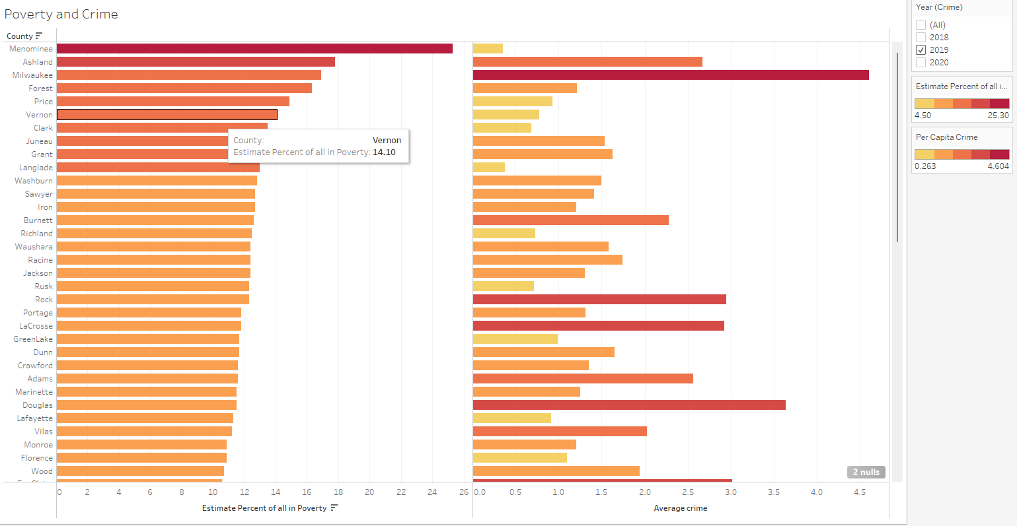
Summary Statistic Crime Interactive Crime Graph
Interactive Graph
Crime can be sorted by year and offense
Scroll to get statistic of per capita crime

Slide 11
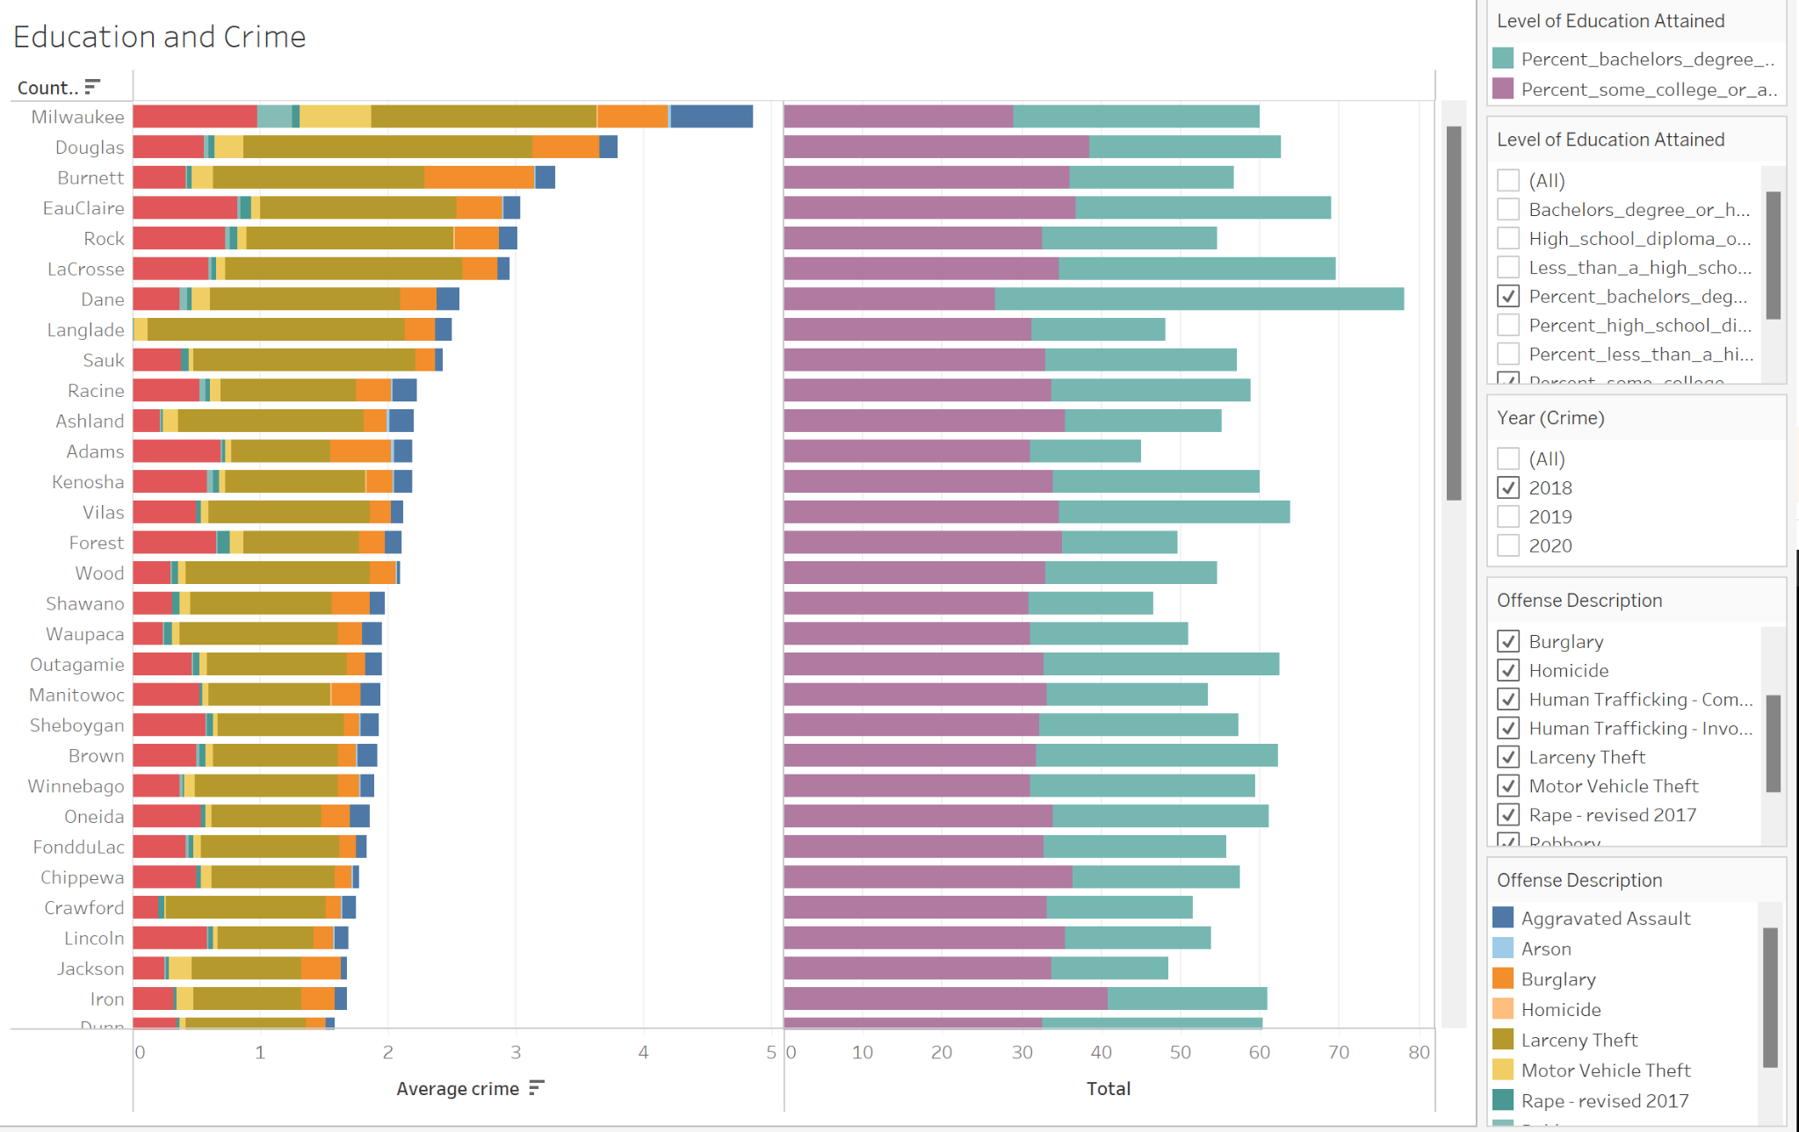
Summary Statistic Crime and Education Interactive Crime Graph
Interactive Graph
Crime can be sorted by year and offense
Sort Education by total degree numbers, percent obtained

Slide 12
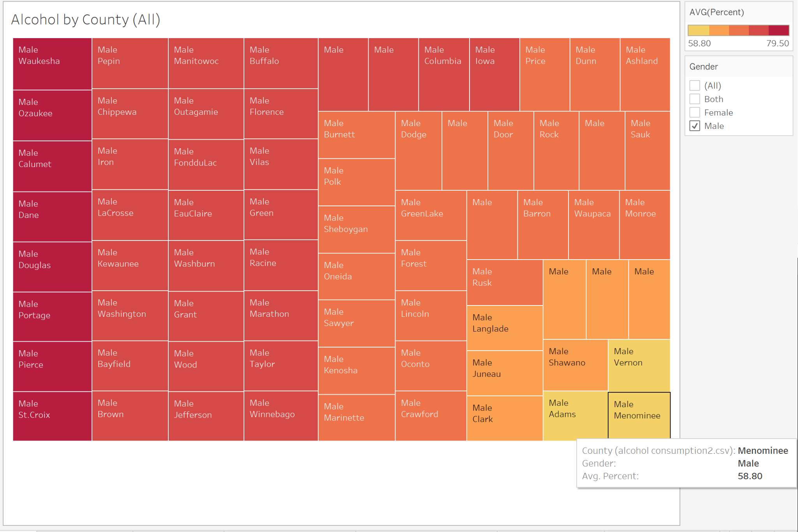
Summary Statistic Alcohol Interactive Chart
Interactive Graph
Click on Gender Filter to add another chart
Progression of Alcohol Use

Slide 13



Database
Our database was created in a PostgreSQL client, pgAdmin, and linked to an AWS RDS instance. A connection was then made from AWS into a jupyter notebook for the machine learning model code using sqlalchemy and psychopg2. This connection ensures that the model will be able to update each time new data comes into the database in the future.

Slide 14
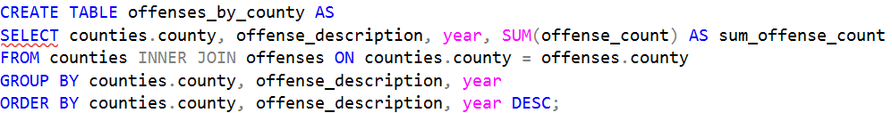
Database
To create the database, nine tables were made and loaded with data we had gathered from multiple sources. We then used SQL inner joins to merge eight of these tables on county. Our offenses data required a bit more work. Once the three datasets were loaded into an offenses table, we wanted to group columns in order to see only pertinent information. The following code was used to do so:
Once we were happy with our new tables, the rest were dropped to keep the database clean. An ERD depicting our original data tables that were dropped can be found on the next slide.

Slide 15
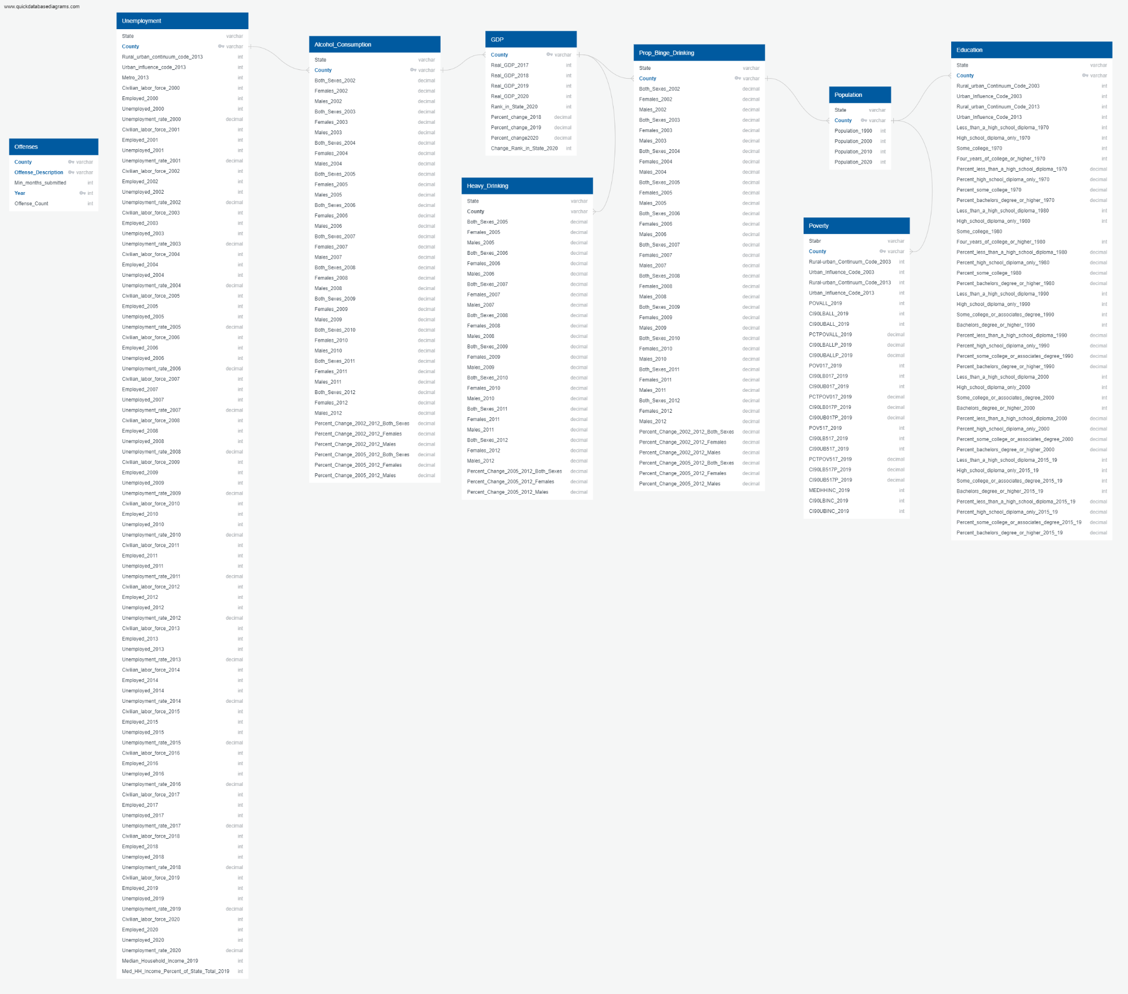
Database ERD

Slide 16
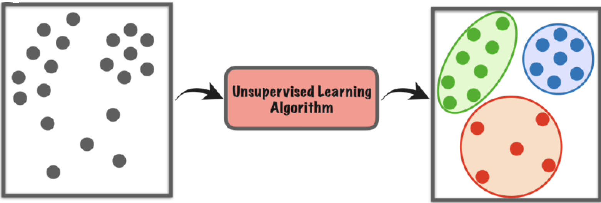
Machine Learning
Why Unsupervised?
The decision to use unsupervised machine learning was due to the question our analysis is trying to answer, what drives crime? The goal is to find variables that are related to crime

Slide 17
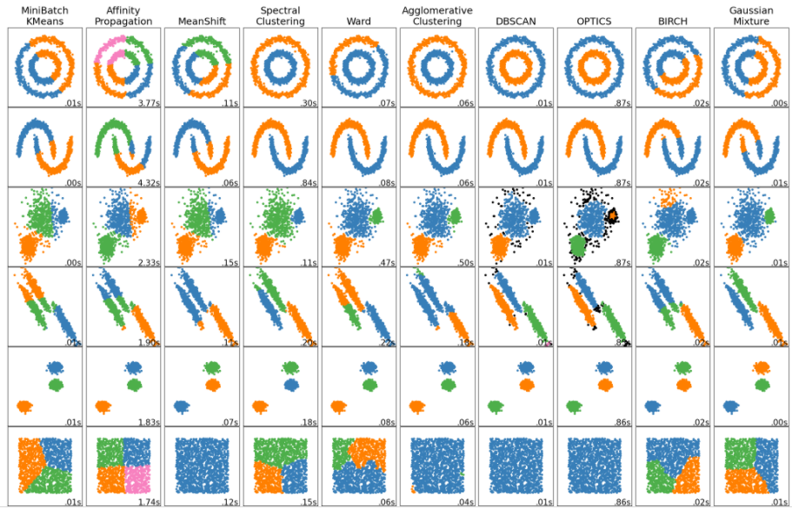
Machine Learning
Models
Scikit-learn
K-Means, DBSCAN are being used to generate relationships at this point
Two other algorithms worth looking into are Optics, and Ward Hierarchical

Slide 18
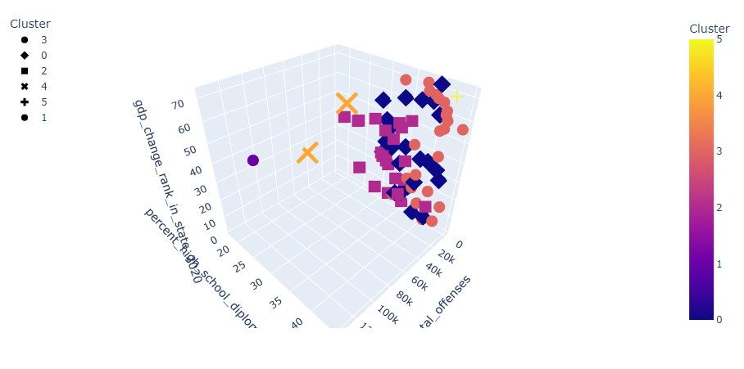
Machine Learning
Interpreting Results
Started with random axis, now using correlation analysis
Attempting to get more defined clusters by changing models, scalers, and refining the variable list

Slide 19
Dashboard Layout
The Dashboard will be created using Tableau, with different interactive elements for the different charts and maps uploaded to the website.
Title/Header
Purpose/Rationale, with overview of data used
Basic Summary Statistic Maps and Graphs, with small write ups about each
Interactive elements that help explain and show the relationship between crime and the various elements

Slide 20
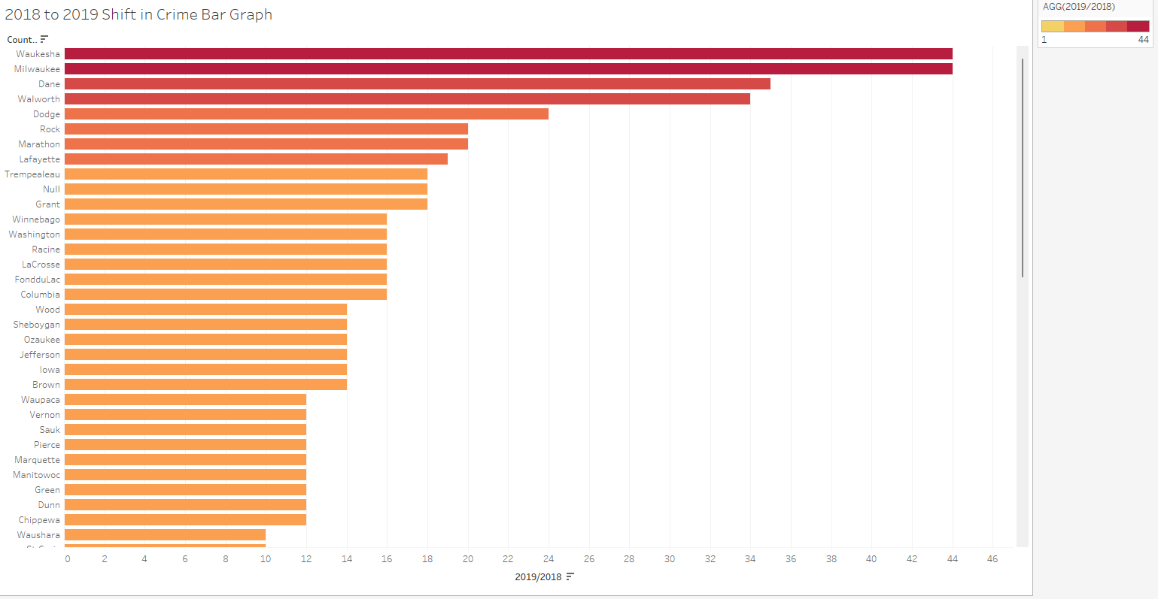
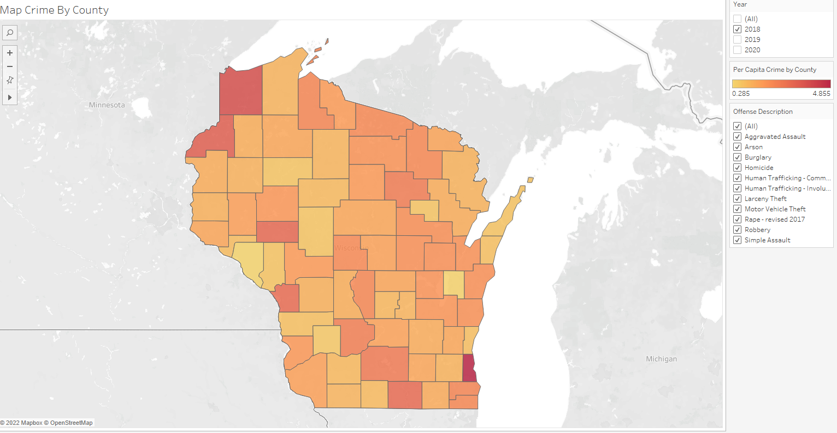
Title
Purpose and Rationale Goes Here
Write up of this graph
Write Up of this map

Slide 21
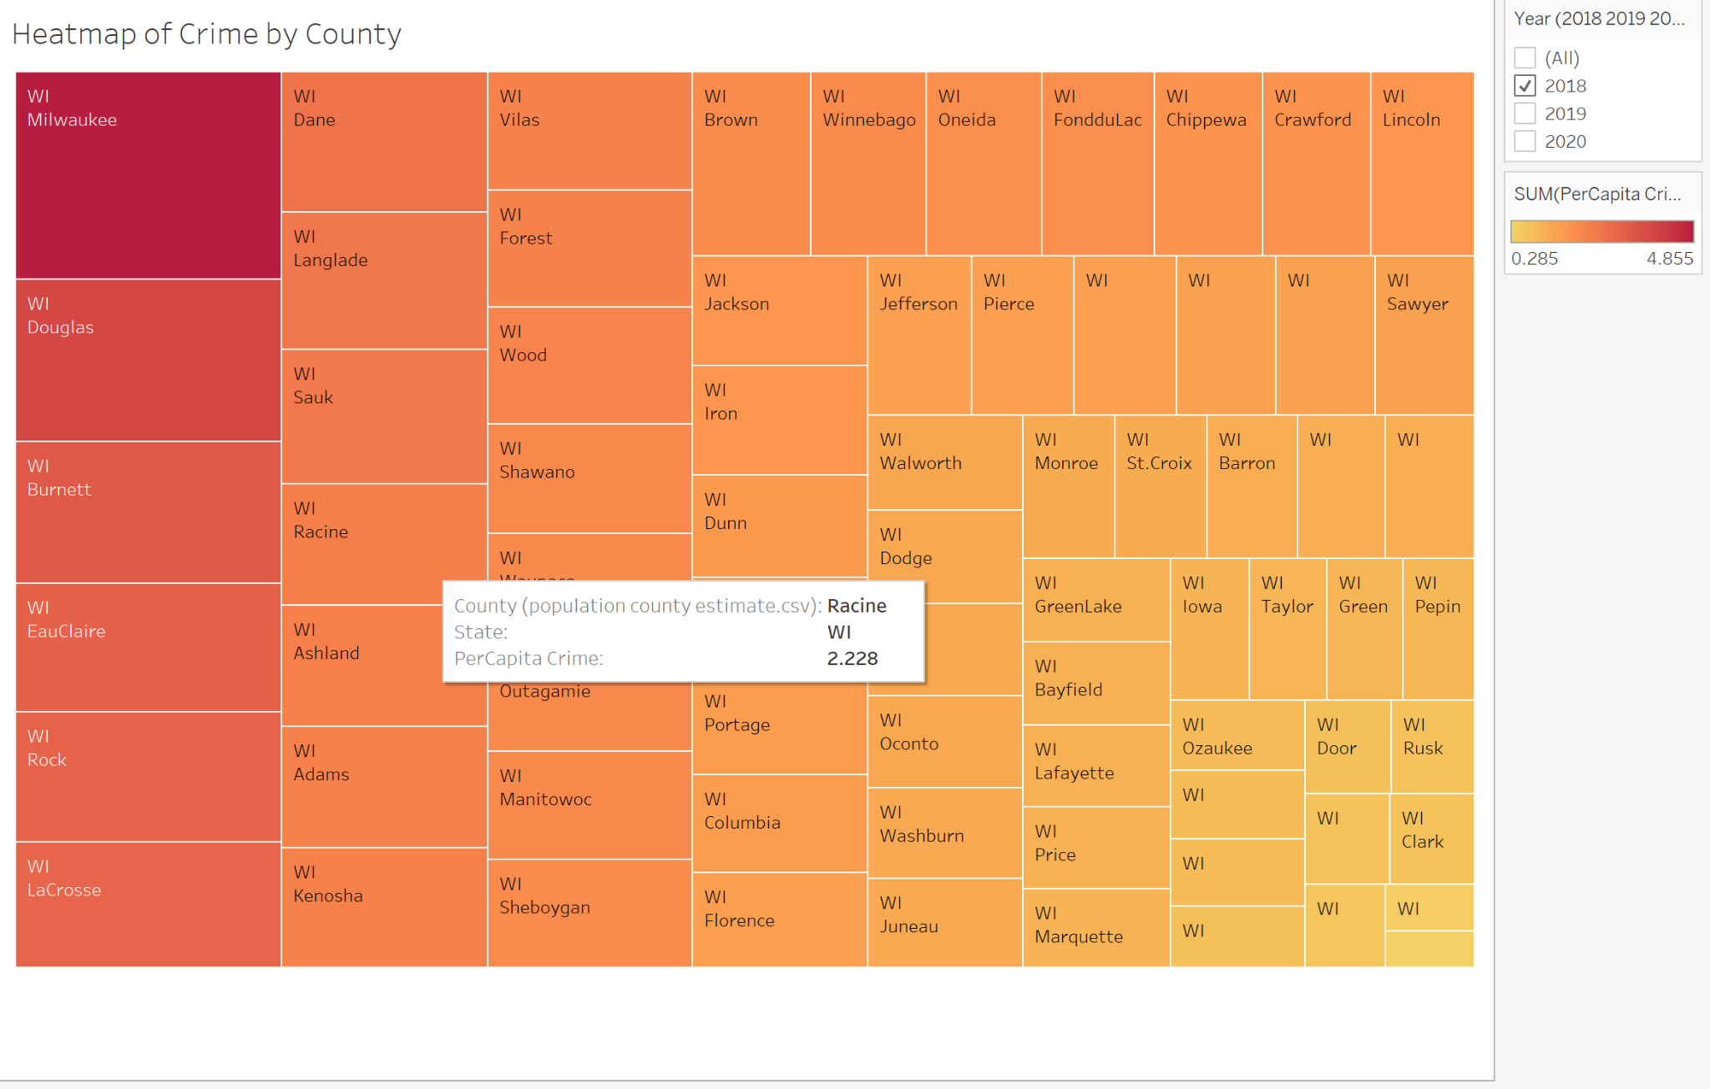
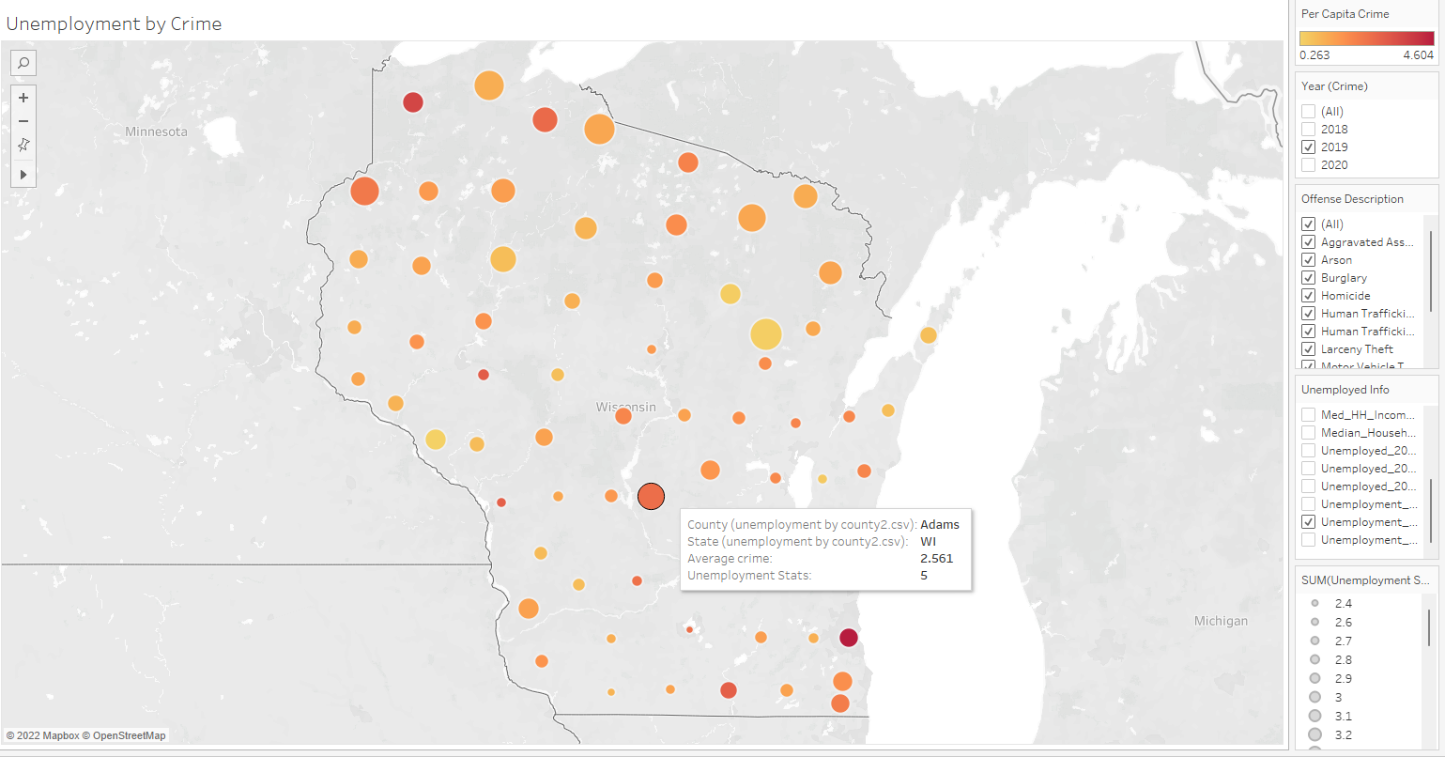
Write up of some broad findings, leading to more interactive elements below for the user to explore
Write up of this graph
Write up of this map

Slide 22
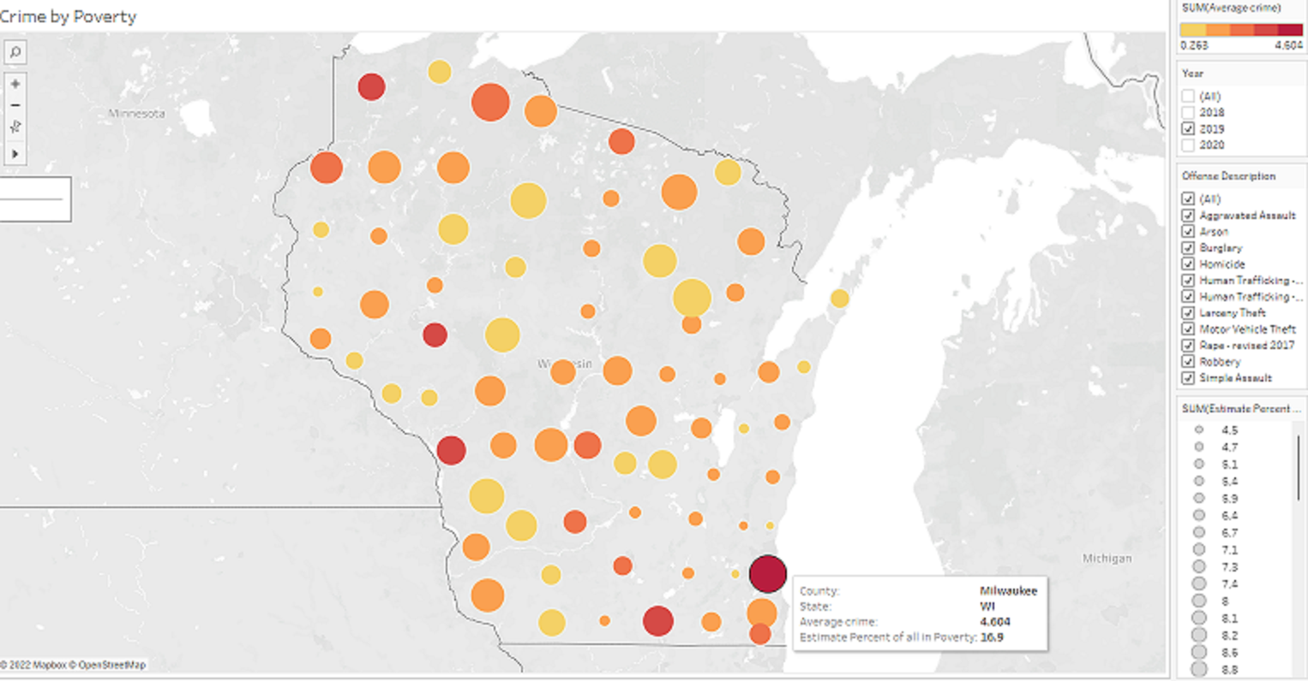
Interactive Elements
Interactive Map
Crime can be sorted by year and offense
Poverty size of the marker

Slide 23
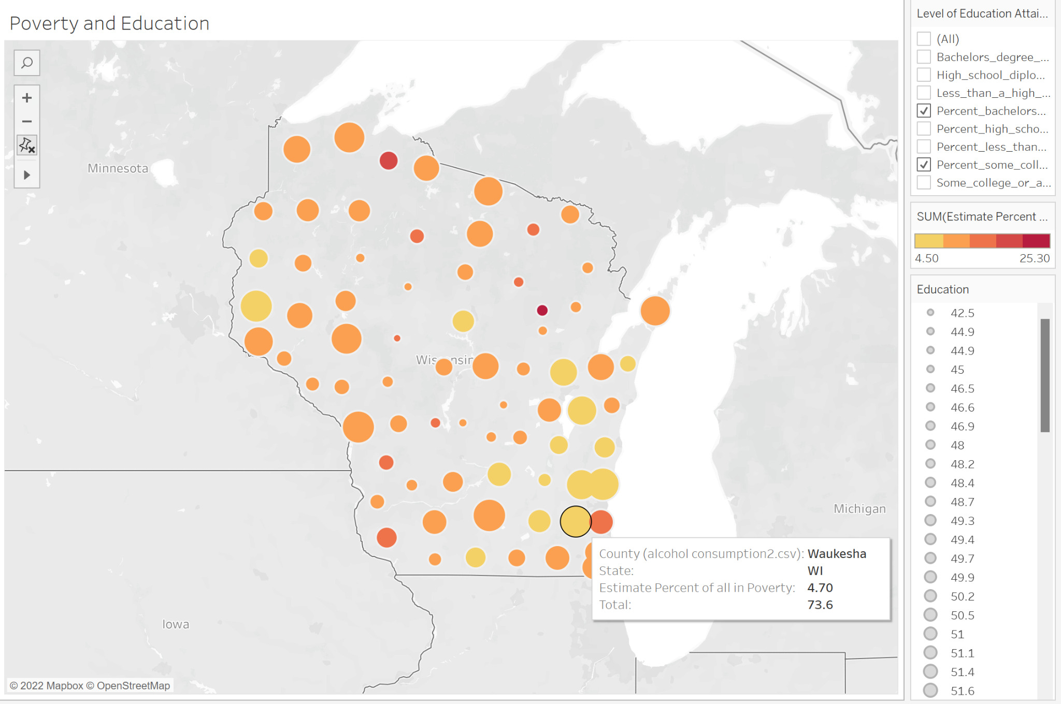
Interactive Elements
Interactive Map
Education by size of marker, can change percent and total number of degrees
Poverty by color

Slide 24
Interactive Elements
Interactive Chart
User can sort by year

Slide 25
Interactive Elements

Slide 26
Preliminary Findings
Preliminary Findings
Positive correlation above .95:
Between different crimes and unemployment and poverty.
Negatively correlated:
County GDP and alcohol use.
Other correlations:
Urban/rural codes were negatively correlated, indicating that crime is both an urban, suburban, and rural issue.
Education had mixed results, appearing both in the top 5% and negative correlation between -.25 and -.54, the lowest correlated variable.

